Slide 1
Part III : Understanding the Infant/Toddler Home Screening Tool

Slide 2
Project Goals, Home Screening Tool Research and Introduction

Slide 3
Project Goals
GOAL # 56 of completed Peer Ed Visits and Screening Tools
Screen for HIGH RISK Homes while Building AWARENESS with Peer Education.
Complete ALL forms of DATA COLLECTION
(Discuss forms at this time next slide)

Slide 4
Project Goals cont..
Completing ALL documents for the Project
Peer Education Intake, Application and Survey forms
Home Screening Tool
Sign of Release for kits
$tipend Request

Slide 5
Pediatric Healthy Homes Screening Tool Founded on Research
+ MI Strategic plan for Healthy Homes
1. Lung Cancer (Radon and ETS environmental tobacco smoke)
2. Unintentional Injuries (including but not limited to Poisonings)
3. Asthma & Allergies
4. Lead Poisoning
+ Institute of Medicine (IOM): Focuses on the association between biological and chemical exposures in the home regarding asthma sensitivities and exacerbation
+ EPR – 3 (Expert Panel Report 3): Guidelines on Asthma by National Asthma Education and Prevention Program expert panel after conducting a systematic review of scientific literature on asthma care. Part of the National Heart, Lung and Blood institute
+ Most importantly this design is Human Centered!

Slide 6
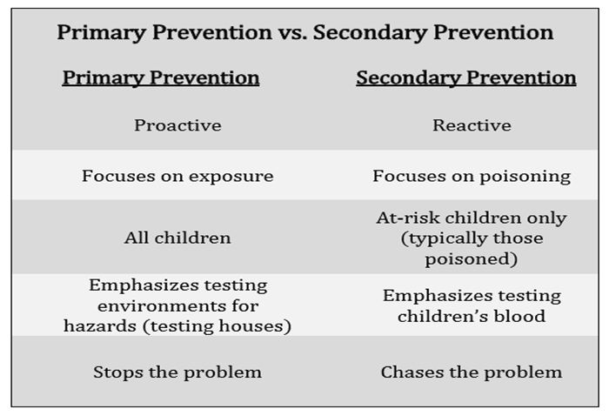
Infant/Toddler Home Screening Project is A Primary Prevention strategy

Slide 7
Turning Learning Objectives into Practice
Effectively recognize sources of lead in the home environment
Know how to get your child tested for elevated blood lead levels (EBLL) and interpret results
Understand the impact of lead on child development
Acquire the skills to reduce lead environmental health risks at home and in the community
Awareness of how children’s behavior and biology can place children at an increased risk for lead exposure
How to advocate for less lead in the home and other child-serving environments
Empower parents and reduce parent blaming
Recognize that socioeconomic disparities can highly influence exposure to lead
Understand the routes/process of lead poisoning and the symptoms
Notes:
Possibly removing this slide, does it seem relevant to parents?

Slide 8
Home Screening Tool Introduction
LEAD focus portion of tool
Estimated time of use is 3.5 minutes!
Tool is mostly visual assessment
Only 2 questions will require feedback from the participant
Last response question: Date range of the home. If this question presents a challenge, Leave it for me

Slide 9
Home Screening Tool Score Range
*Healthy Homes will score ALL completed Screening Tools*
High Risk: Receive additional services at Healthy Homes Coalition
Moderate Risk and Low Risk: Receive mailout education packet and follow up contact info to Healthy Homes

Slide 10
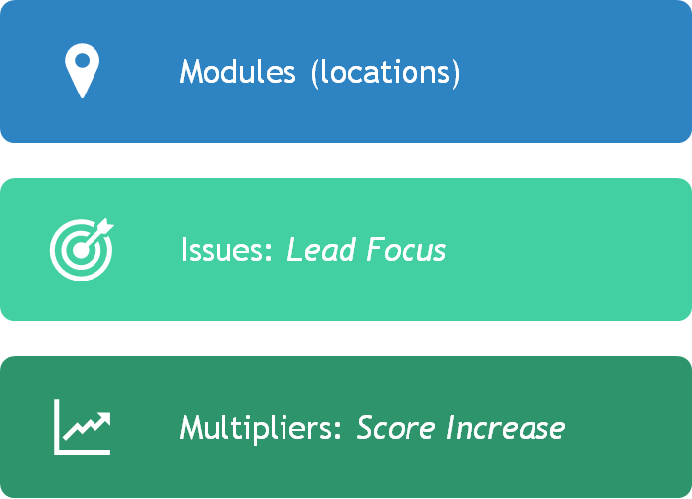
Home Screening Tool Introduction cont. . .

Slide 11
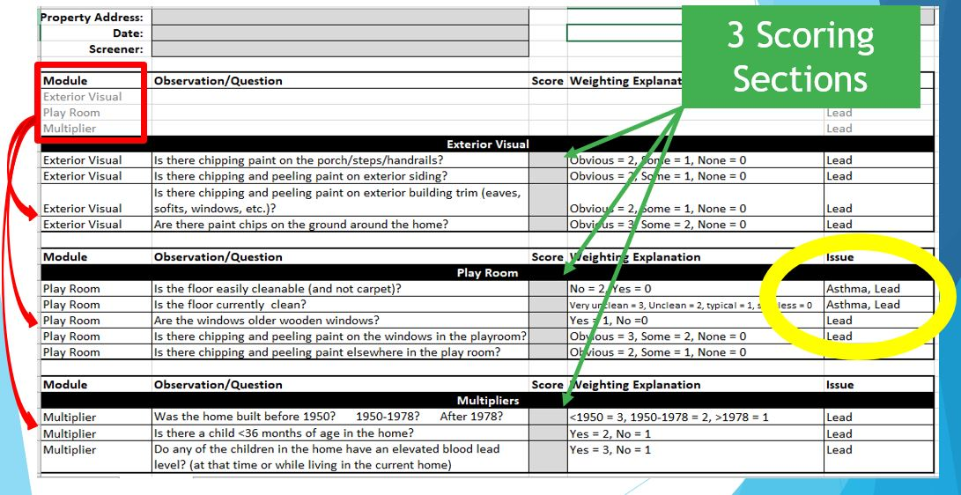

Slide 13
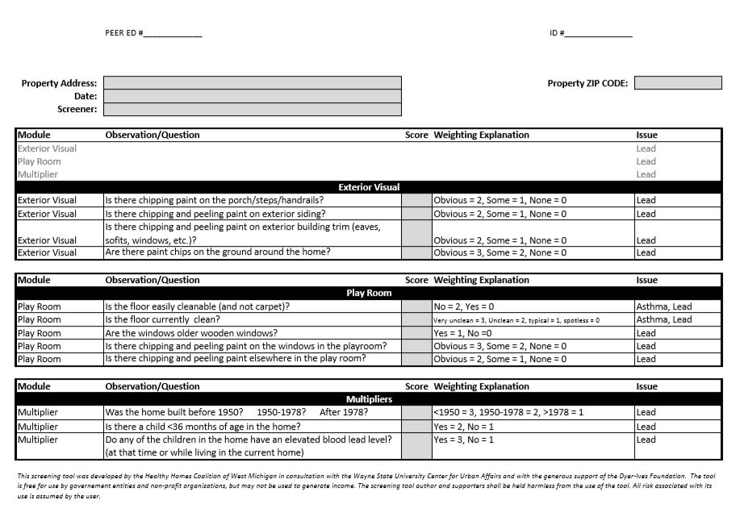

Slide 14
Research, Project Goals and Home Screening Tool introduction

Slide 15
Rater Reliability Tips, Tool Practice and Group Discussion

Slide 16
MODULE: “EXTERIOR”
Where to LOOK!

Slide 17
Rater Tips
Uncommon Areas: specific areas that can add to the most contribution of lead exposure / legacy. These areas are not always common!
Paint: Paint can have many layers on a surface, especially in older homes. Painted surfaces that seem uneven are sometimes because of the condition of the paint underneath the newest painted layer. However, the top layer of paint should be completely sealed showing no splits or flaking. The amount of cracking or flaking of paint chips will determine the severity.

Slide 18
Tips continued. . .
WHEN APPROACHING THE HOME
Hot spots include: Yard and dripline, all painted surfaces (ex. Fascia, soffits, steps, handrails, porch flooring or porch cement, doors and doorways)

Slide 19
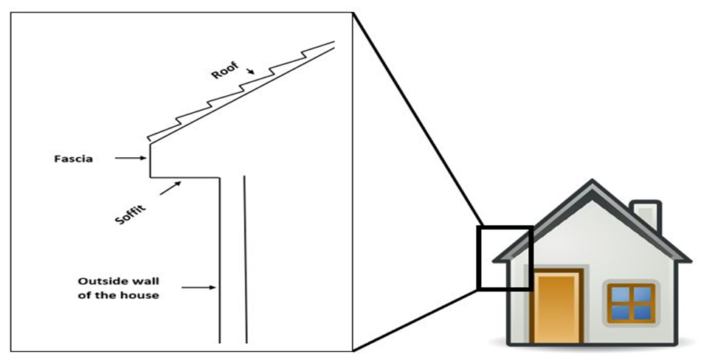

Slide 20
Let’s Practice the Exterior!

Slide 21
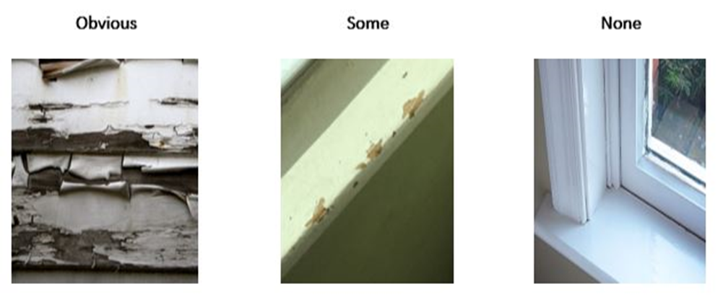
Chipping Paint Scale

Slide 22
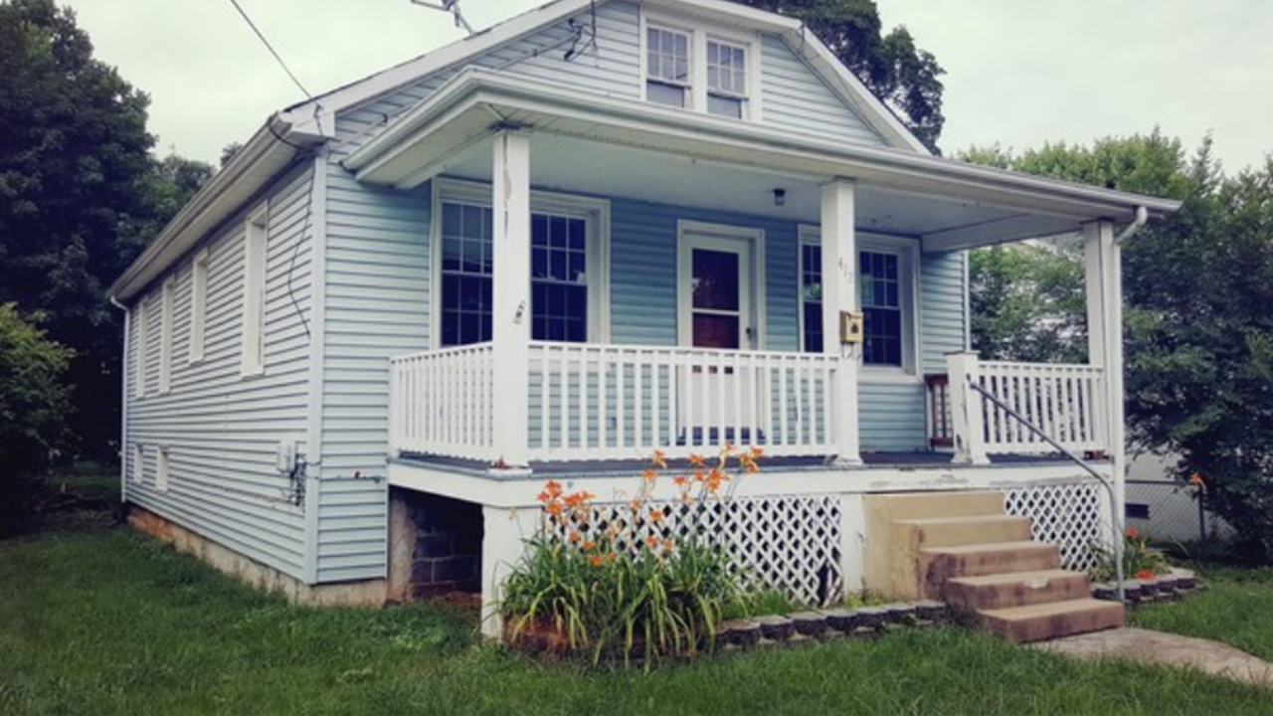

Slide 23
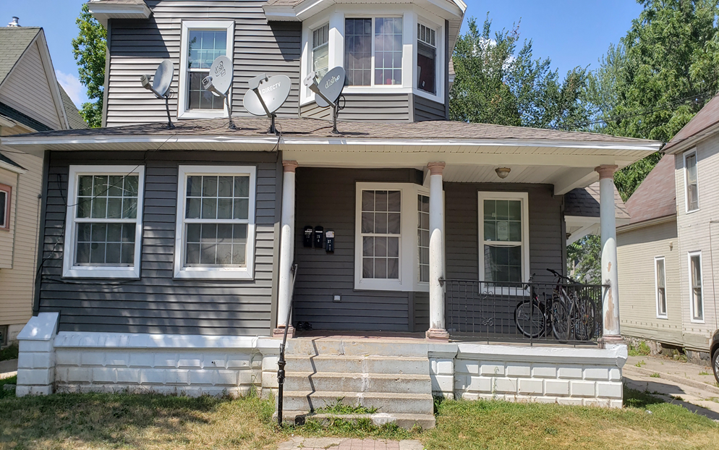

Slide 24
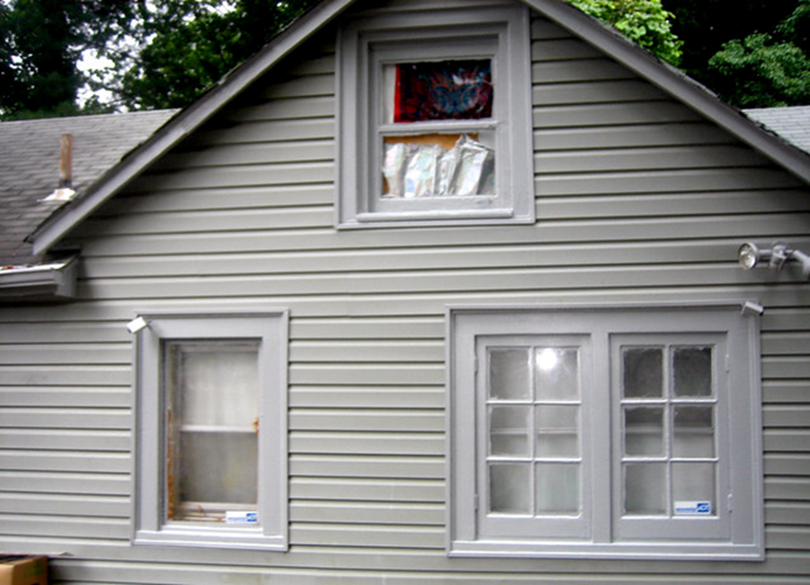

Slide 25
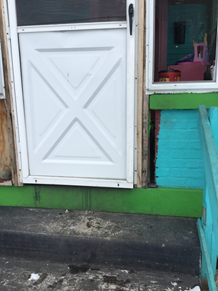
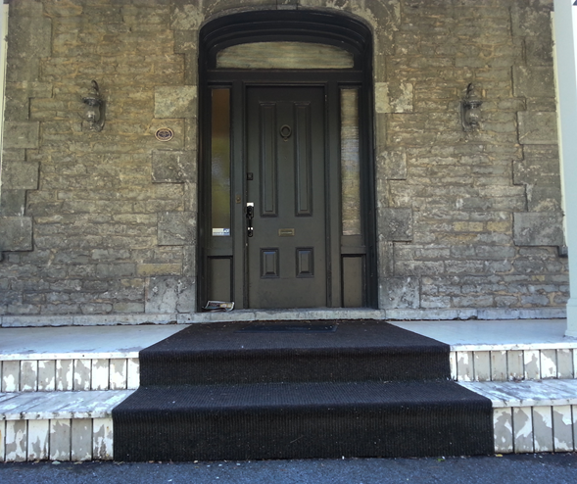
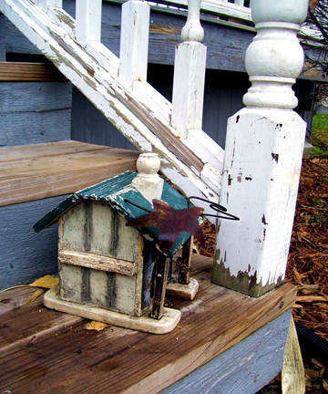
Look for indicators along the way

Slide 26
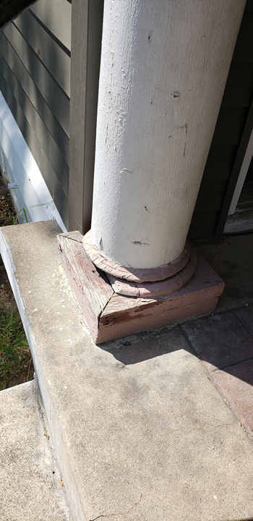
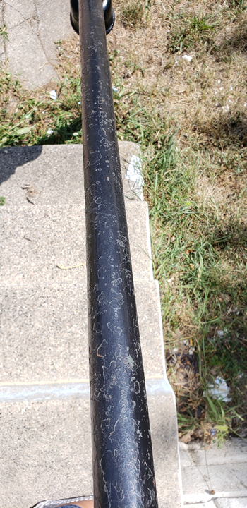

Slide 27
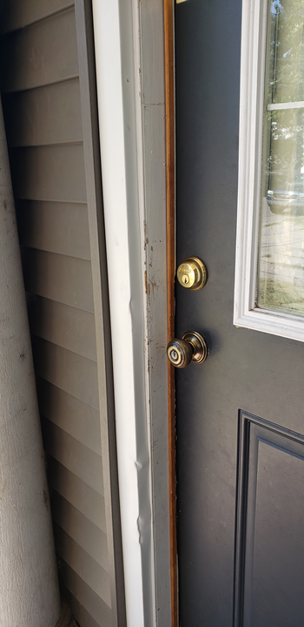
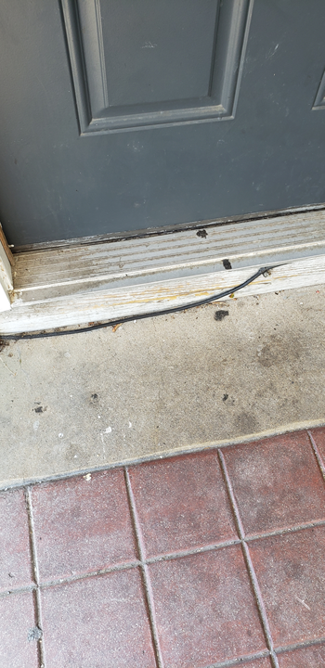

Slide 28
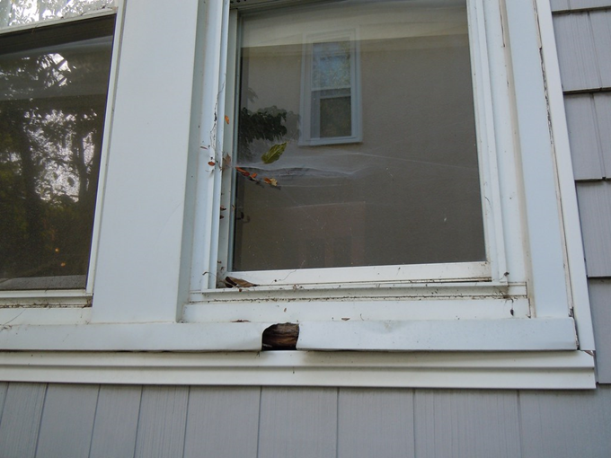

Slide 29
MODULE: “PLAY ROOM”
(Any area of the house where children spend the most time)
Hot spots include: Cleanable flooring, play areas, doors and doorjams (TRIM), dated windows, window sills and troughs, any interior trim in poor painted / varnished condition.

Slide 30
Let’s Practice the Interior!

Slide 31
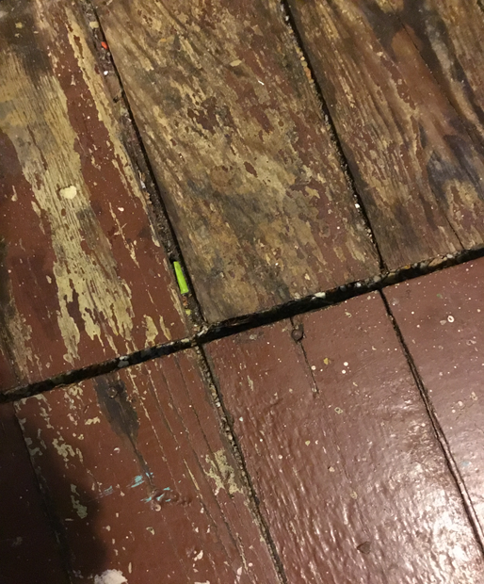
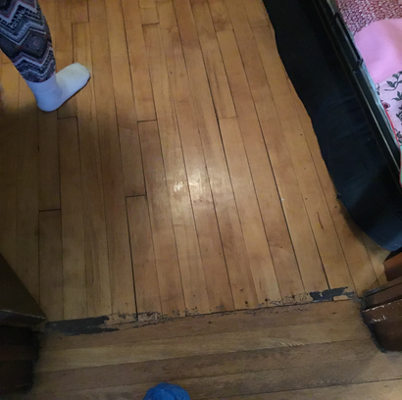

Slide 32
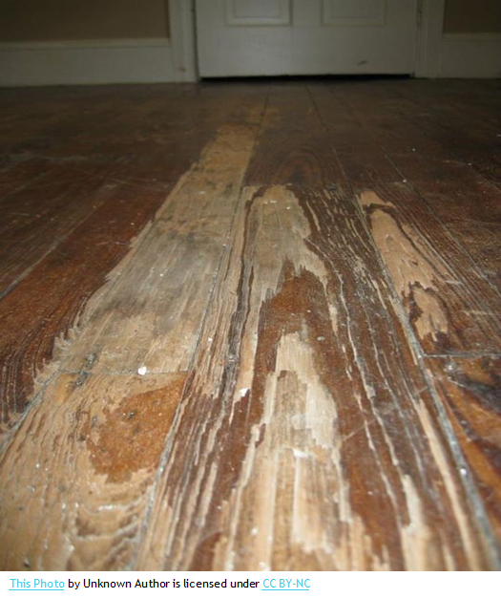
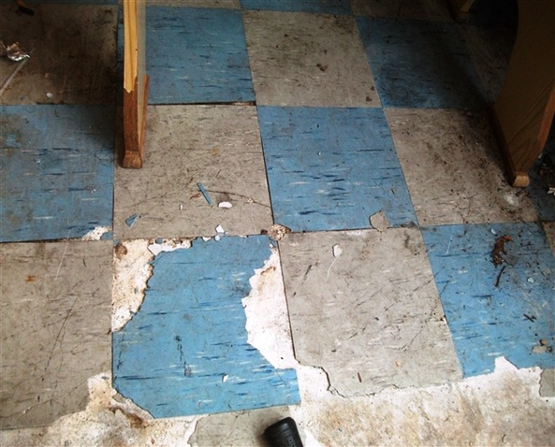

Slide 33
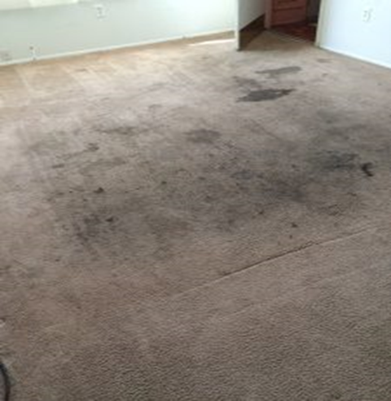
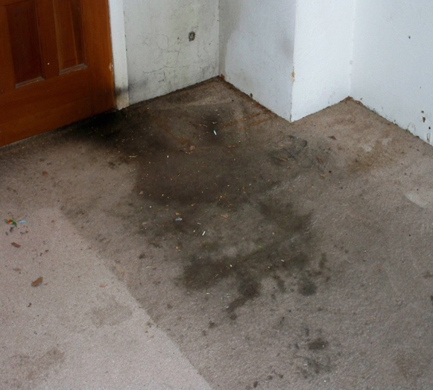
Is this CLEANABLE?

Slide 34
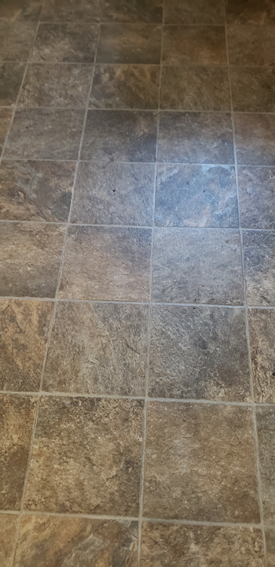
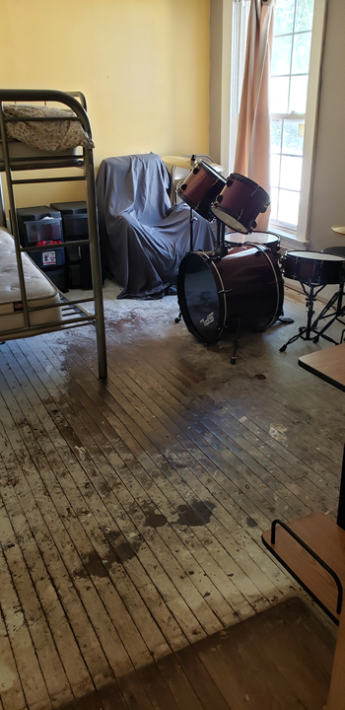

Slide 35
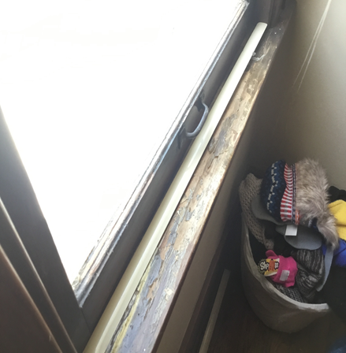
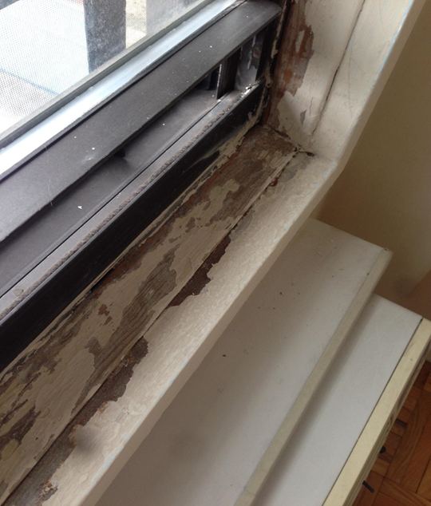

Slide 36
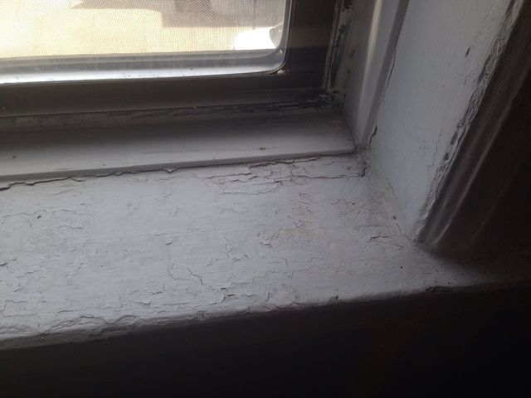

Slide 37
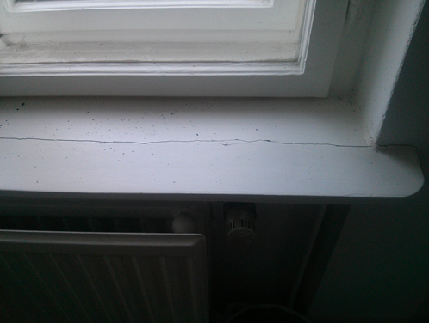

Slide 38
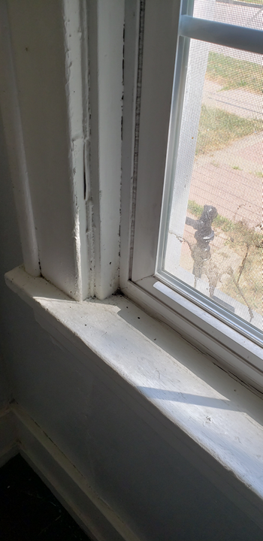
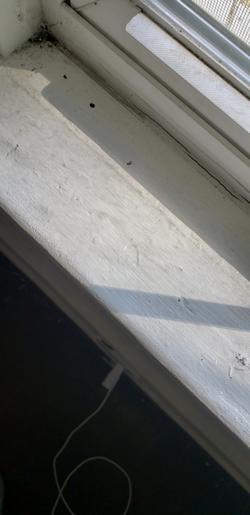

Slide 39
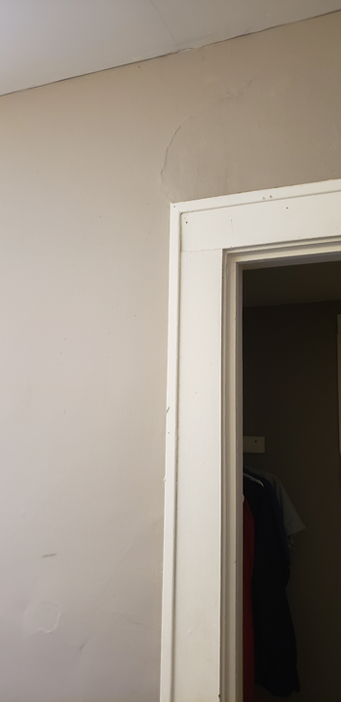
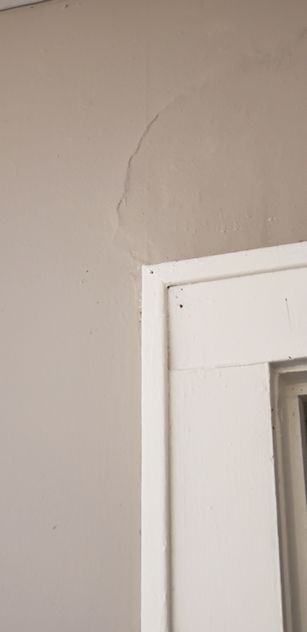

Slide 40
Rater Reliability Group Discussions
(See additional pictured handout and discuss)

Slide 41
Questions & Answers,
RECAP and Training Survey

Slide 42
Before you Go!
Please take a few minutes to complete the training surveys

