Slide 1
Lead 101
Peer Education Program
Notes:
Slides with Healthy Homes branding (on bottom) will be shown to the parents. The non-branded slides are just “cue cards” for educators

Slide 2
Who am I?
Notes:
Who am I (peer educator)?
Why am I here and from where?

Slide 3
Getting to know you!
Verify contact information
What do you want to know?
Notes:
Getting to know you (parent)?
Instructional design also says to collect demographics at beginning. However, I’m assuming that this can be moved to the end since this is part of the post-visit survey

Slide 4
Agenda
Our goal today is to be proactive. We can’t change the past, but we can change the future.
Introduction
Part I: Awareness and Knowledge
What is lead and where does it come from?
What is lead poisoning?
Effects of lead poisoning on young children?
Symptoms
Diagnosing lead poisoning
What do the test results mean?
Preventing lead exposure and poisoning
Part II: Understanding and Skills
Activity one: Where in the world is Lead?
Activity two: Dust Busters!
Activity three: Duct tape activity (????)
Part III: Understanding the Infant/Toddler Home Screening Tool
Project Goals and Supplies, Home Screening Tool Research and Introduction
Rater Reliability Tips, Tool Practice and Group Discussion
Q & A, RECAP and Training Survey

Slide 5
Part I :
Health and Environment Knowledge and Awareness

Slide 6
What is lead poisoning?
Lead poisoning occurs when lead builds up in the body through swallowing or breathing in lead
May take months or years to build up
Young children are most vulnerable since they play on the ground/floor
May come into contact with lead in the soil or dust

Slide 7
Children love to play and explore
these typical behaviors may expose children to lead
These behaviors are good, however….
Notes:
SHARE WITH PARENT

Slide 8
Sweet’n Low
One gram = One million micrograms
Experts agree that one square foot of a floor is hazardous when lead dust exceeds ten micrograms.
One gram of lead dust can make 100,000 square feet hazardous.
The typical US house is 2,700 square feet.
One gram of lead dust is enough to make all the floors in 37 US homes hazardous.

Slide 9
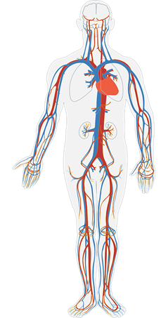
Pathway to the Brain
Notes:
SHARE WITH PARENT

Slide 10
Exposure to large amounts of lead is rare
Exposure to small amounts over a long time is common and just as dangerous
10
40
40
10
40
10
10
Notes:
SHARE WITH PARENT

Slide 11
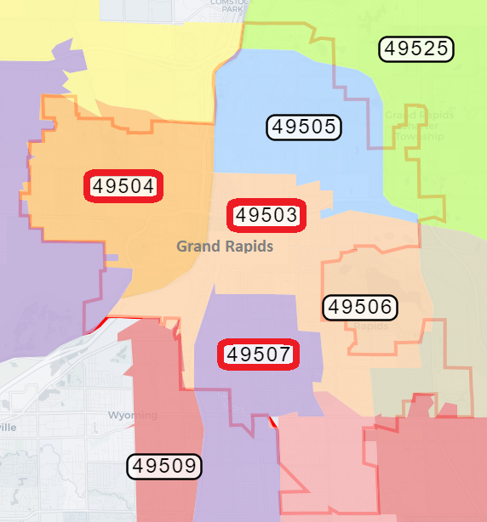
High Risk Zip Codes
High risk areas for childhood lead poisoning in Grand Rapids include:
49504
49503
49507
Notes:
SHARE WITH PARENT

Slide 12
Percent of children < 6 years old in Kent County screened for blood lead 2010-2015
Kent County Suburbs
Grand
Rapids
53.3 %
47.7%
Notes:
SHARE WITH PARENT
PAUL (11.02) I think we still have a denominator problem here. From both it is too easy to assume that the 80% for Grand Rapids suggests the denominator is all kids tested, when in fact the denominator is all kids with EBLs. I do not have the data to keep the denominator the same. So to keep this simple, my recommendation is that we show the graphic on the left, and not the graphic on the right.

Slide 13
Who is at the Greatest Risk?
Infants and Children
Developing brains and nervous systems more sensitive to damaging effects of lead
Hands and objects frequently placed into mouth
Children’s growing bodies absorb more lead than adults
Children play and crawl on the ground and floor
Notes:
SHARE WITH PARENT
Emphasize that children are not little adults. Children absorb more lead and their brains are still developing.

Slide 14
Exposure to Lead Can Seriously Harm a Child’s Health
Damage to brain and nervous system
Learning and behavior problems
Slow growth and developmental delays
Hearing and speech problems
Notes:
SHARE WITH PARENT

Slide 15
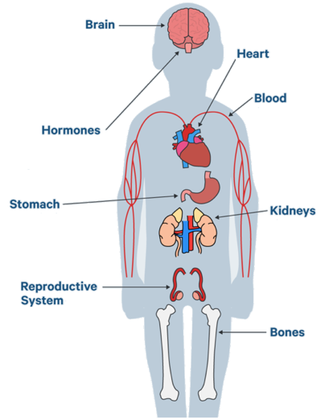
Potential effects/outcomes of lead poisoning
Prenatal Exposure:
Premature birth
Lower birth weight
Slowed physical growth
Impaired brain development
Childhood Exposure:
Developmental delays
Learning difficulties
Seizures
Irritability or fatigue
Loss of appetite, vomiting, weight loss
Abdominal pain
Constipation
Hearing loss
Eating non-food items
Notes:
SHARE WITH PARENT
PAUL (11.02) - Picture of child suggests that we can rely on symptoms. I would prefer pic of pregnant woman

Slide 16
What is lead?

Slide 17
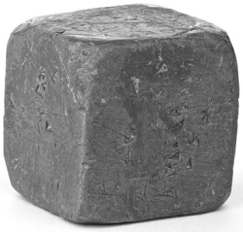
What is lead and where does it exist?
Naturally occurring metal
Remains in the environment for long periods
Used in house paints (pre-1978) and gasoline (pre-1986)
Also found in pipes, pottery, fishing weights, and ammunition

Slide 18
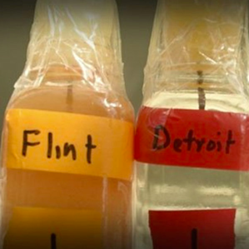
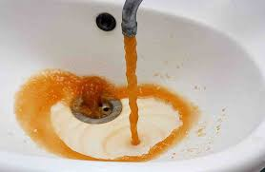
Unfortunately, lead has been in the news a lot lately

Slide 19
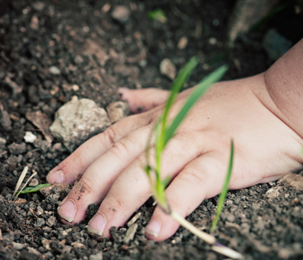
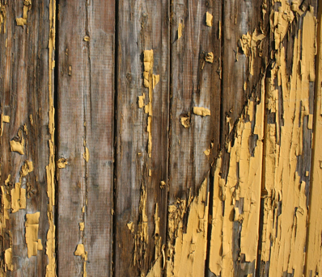
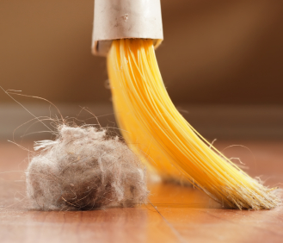
But remember...
Lead can be in more than just the water!
Notes:
SHARE WITH PARENT

Slide 20
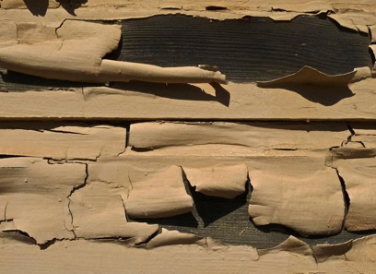
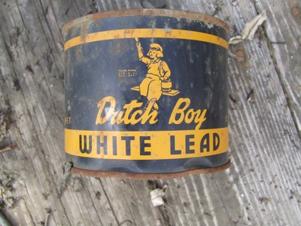
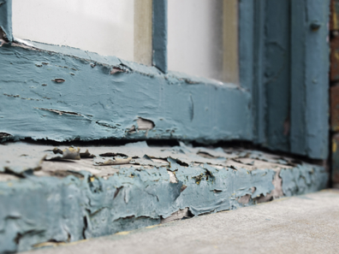
Paint
Older homes (built before 1978) are more likely to contain lead-based paint
Paint may chip from window sills, door frames, and porches
Promptly remove paint chips or cover damaged paint until repairs can be made

Slide 21
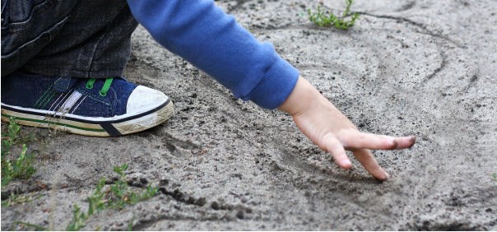
Soil
Exterior lead paint, leaded gas, and industrial sources contaminate soil
Lead exposure can be mitigated by:
Washing hands after outdoor play
Not wearing shoes indoors
Notes:
Covering soil
Grass
6” of wood chips
Concrete
What else can you think of?
Gardens: not by drip lines of buildings. Consider raised beds with off-site soil.

Slide 22
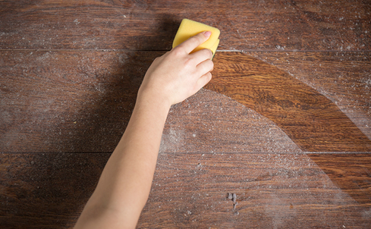
Dust
Household dust may contain lead from:
Deteriorating lead paint
Home repair activities
Tracking from the outdoors
Lead dust on clothing
Limit lead dust in your home by:
Repair sources
Cleaning often
Removing paint chips
Not wearing shoes indoors

Slide 23
Part II :
What can YOU do? Skills to reduce risk

Slide 24
How can I assess hazards in the home?
Types of assessments:
Visual assessment
Lead-check swabs
Dust and soil samples
LIRA
Helpful resources:
MDHHS Is Your Child Safe From Lead Poisoning? Handout
List of state-certified inspectors/assessors
MDHHS Testing Your Home Brochure

Slide 25
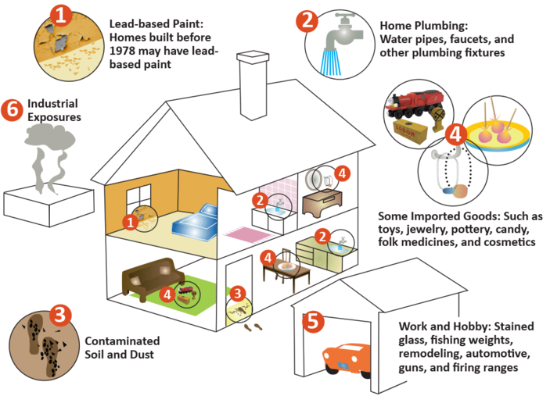
Let’s do a walkthrough!
Notes:
SHARE WITH PARENT

Slide 26
Water
Run water before using
Clean the aerator
How to clean aerator handout
Filter
Cheaper than testing
Where to get water filter handout

Slide 27
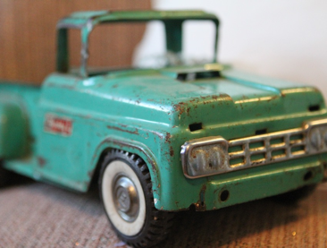
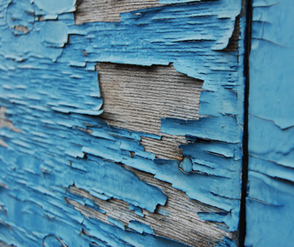
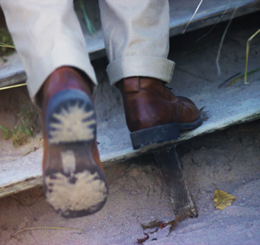
Where else does lead exist?
Notes:
SHARE WITH PARENT
Paul may have lead service line picture I believe?

Slide 28
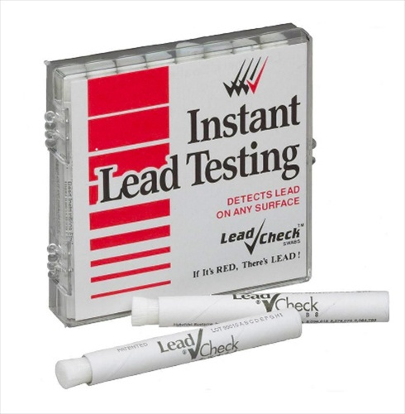
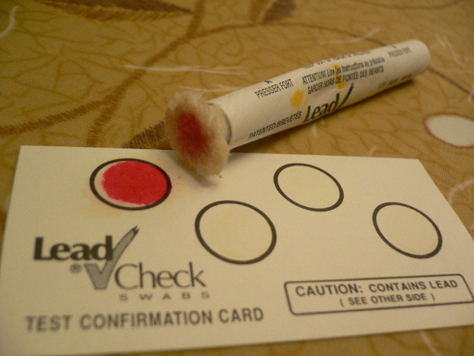
Lead Swab Test
Notes:
SHARE WITH PARENT
Paul may have lead service line picture I believe?

Slide 29
How can I address home hazards?

Slide 30
Lead-Safe Cleaning Demonstrations
Notes:
*Do demonstration and go over LSCP handout
Double-bucket mopping
Spray bottle and paper towel
Cleanable surfaces

Slide 31
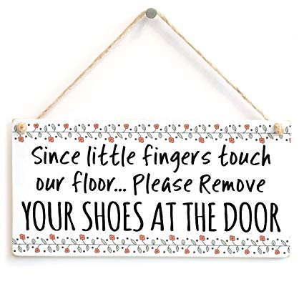
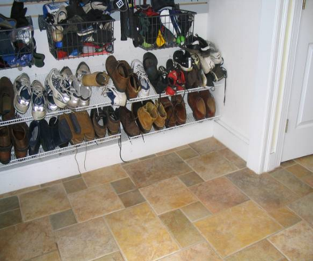
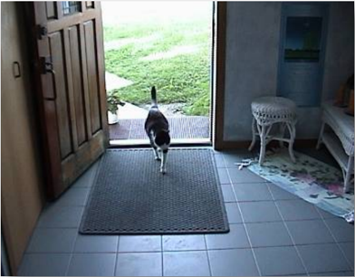
Shoes Off at the Door Policy
What strategies could you use?
Notes:
SHARE WITH PARENT

Slide 32
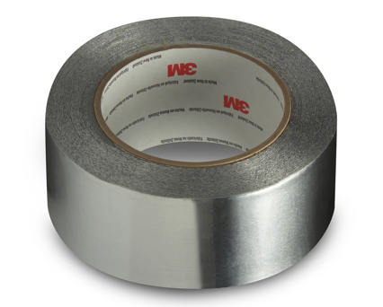
Low-cost solutions
Duct tape and contact paper
Close the door
Plant grass and apply mulch
Put couch in front of lead hazards
Don’t open windows with chipping paint
What methods could you use?
Notes:
Simple-Low cost solutions (~10 min)

Slide 33
Repairing Lead Hazards
Go over binder resources
Get the Lead Out!
RRP-certified contractors
DIY = LSWP
Screen for GTLO eligibility
Complete Home Screening Tool
What will you most likely do?
Notes:
Go over handout (Get the Lead Out!; RRP-certified contractors, Do it yourself using LSWP resources)

Slide 34
How can I test my child for lead?
Notes:
Go over lead testing handout with parent

Slide 35
How can I test my child for lead?
Where can I get my child tested?
Primary care provider
Ask your primary care provider to test if they haven’t
WIC
Kent County Health Department can help
When to test?
See MDHHS Provider Quick Reference handout
What do the test results mean?
See MDHHS What Your Child’s Blood Test Means handout

Slide 36
How else can I reduce lead poisoning risks?

Slide 37
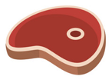
Limit lead absorption by eating foods high in:
Calcium
Iron
Vitamin C

Slide 38
Reduce the impact of lead poisoning through nurturing
Positive childhood experiences stimulate your child’s brain development
Limit the effects of lead through:
Reading with your child every day
Engaging in learning activities
Promoting social skills
Preschool high-quality, state-licensed

